Slide 1
“(What) To Eat or Not To Eat?”
Shivani Narasimhan, M.D.
Annapolis Endocrinology
(Annapolis & Silver Spring)
www.annapolisendo.org

Slide 2

The Heavy Toll of Diet-Related Chronic Diseases
Diabetes
81 million Americans (37% of the population) have Cardiovascular disease
Major Risk factors
High cholesterol
Type 2 diabetes (adult onset)
High blood pressure
Overweight status
Physical inactivity
Tobacco use

Slide 3
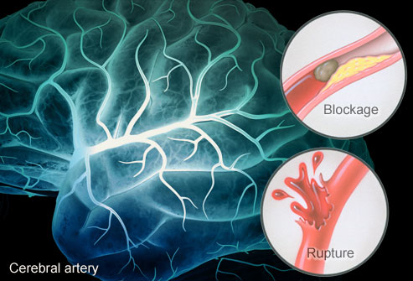
High Blood Pressure
Stroke (block or burst)
75 million Americans (34% of the population)
Stroke
Heart disease
Congestive Heart Failure
Kidney Disease
Dialysis
Dietary Factors
High Sodium (Salt)
Obesity
Excess Alcohol Intake

Slide 4
Diabetes
24 million Americans (11% of population) have diabetes
80 million Americans
(35% of population) have pre-diabetes
Those statistics add up to the fact that nearly HALF of all Americans have sugar problems!
Majority of them are suffering from Type 2 diabetes (related to weight)

Slide 5
Diabetes
Type I
Juvenile
Immune attack on the pancreas results in insulin deficiency
Insulin dependent from day of diagnosis
Type 2
Had been adult onset
Now being diagnosed in children as young as 8 years old due to obesity
Higher the weight, higher the sugar, thus increased risk of type 2.
Can be treated with pills but often requires insulin shots

Slide 6
Type 2 Diabetes
Worsens faster in kids than adults
If type 2 diagnosed in kids, their need to go on to insulin will be sooner than an adult diagnosed with type 2.
Diagnostic Criteria for Type 2:
Fasting glucose: >= 126.
Random glucose: >= 200
A1c: >= 6.5%
Diagnostic Criteria for Pre-Diabetes:
Fasting glucose 100-125
A1c: 5.6 % - 6.4%

Slide 7

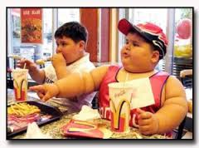

Americans Then and Now
1960s
2013

Slide 8
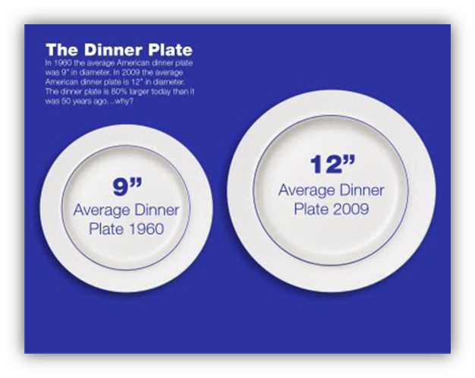

Average inc of 600 calories/day (mainly added fats, oils, sugars)

Slide 9
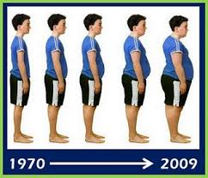

Slide 10
Obesity in America
Then
Now
1970s
2-5 yrs old: 5%
6-11 yrs old: 4%
12-19 yrs old: 6%
Adults: 15%
2000s
2-5 yrs old: 10%
6-11 yrs old: 20%
12-19 yrs old: 18%
Adults: 34%

Slide 11
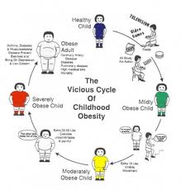
Most habits start young.

Slide 12
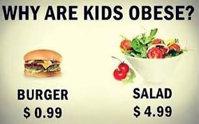

The choice is easy. Or is it…?

Slide 13
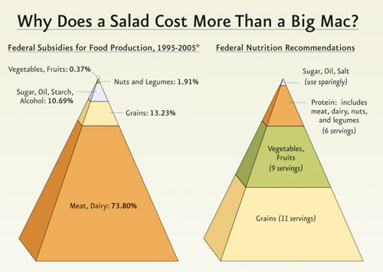

Slide 14
Top 10 Sources of Calories in America
1. Grain-based desserts
2.Breads/Pizza
3. Soda
4. Chicken dishes
5. Pasta
6. Alcohol
7. Beef/Burgers
8. Dairy
9. Potatoes/Chips/Tort’ls
10. Ready to eat cereals

Slide 15
Calories per food group
Carbs 4 calories/gram
Proteins 4 calories/gram
Fats 9 calories/gram

Slide 16
Recommended Macronutrient by Age
Age Carb % Protein % Fat %
1-3 45-65 5-20 30-40
4-18 45-65 10-30 25-35
Adults 45-65 10-35 20-35

Slide 17

Strongest link between obesity and food is when one or more fast food meals are consumed per week.

Slide 18
Dietary Guidelines for Americans
2010
U.S. Department of Agriculture U.S.
Department of Health and Human Services
www.dietaryguidelines.gov

Slide 19
Recommended Calories/Day
Gender Age Sedentary Active
F/M Child 1000 cal 1400 cal
Female 4-8 1200 cal 1600 cal
10-15 1500 cal 2000 cal
16-30 1800 cal 2200 cal
31-50 1800 cal 2200 cal
51+ 2000 cal 2600 cal
**Male age 10 onwards, add 200-400 cal/day to the above.

Slide 20
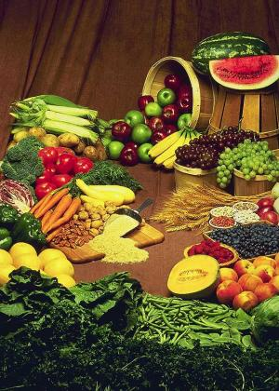
Foods to Increase
Veggies and Fruits
Dark-green, red, orange
Beans and Peas
Whole grains
Half of all grain intake/day
Dairy intake
Fat free or low fat milk
Yogurt/Cheese
Soy beverages
Protein variety
Lean meats
Poultry/Fish/Seafood
Eggs
Soy products/nuts/seeds

Slide 21
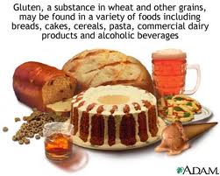
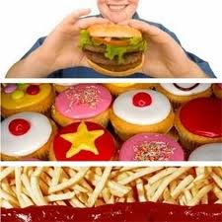
Foods to Decrease
Sodium
<2000 mg/day
Limit consumption of sugars, refined grains and added sugars/fats
Processed foods
Saturated Fats
<10% of calories/day
<300mg cholesterol/day

Slide 22
Trans fatty acids
Found naturally in some foods by grazing animals
Thus found in small quantities in milk or meats
They are NOT essential in diet.
Inc risk of CV disease w/inc in trans fatty acid
Formed during processing of some foods
Found in partially hydrogenated oils used in:
Margarines
Snack foods
Ready made desserts
Help increase shelf-life of food

Slide 23
Added Sugars
Naturally in fruit (fructose)
Naturally in milk (lactose)
Majority of sugars in typical American diet are “added sugars” (sucrose) such as:
High fructose corn syrup
Corn syrup solids
Raw sugar
Malt sugar
Maple syrup
Pancake syrup (maple or corn syrup)
Fructose sweetener
Honey, Molasses
Dextrose

Slide 24
The Devil’s in the Details
Unless the package states it is “100% juice” it is not all juice. It is likely <25% juice, the rest is added sugar water.

Slide 25
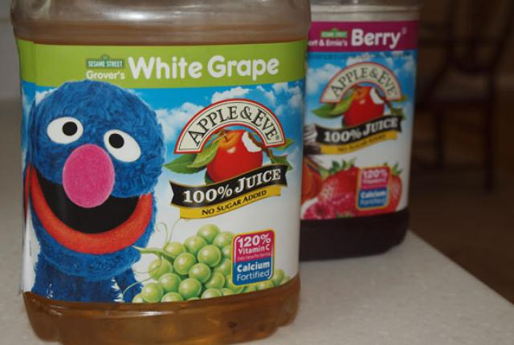

Must say 100% juice, otherwise <25% juice, rest is added sugar water
Ingredients: 100% Juice, With Calcium, No Sugar Added, Fortified W/ Vitamins A, C and E.
Juice Blend
Ingredients: Water; Sugar; Apple, Orange, and Water Extracted Orange Juice Concentrates; Citric Acid; Natural Flavor; Vitamin E Acetate.

Slide 26
Juice and Chocolate Milk
Limit 100% fruit juice to 8-12 oz/day for kids 7 yrs and older.
4 oz fruit juice= 1 serving of fruit
But without the fiber & nutrients of the whole fruit
If a child would not otherwise drink milk, then lightly added chocolate powder is acceptable.

Slide 27
Grains– what’s the difference?
Whole grains
Entire grain seed (called the kernel)
Consumed as single food (wild rice, popcorn)
Or as ingredient in foods (cereals, breads, crackers)
Buckwheat, bulgur, millet, oatmeal, quinoa, rolled oats, brown or wild rice, barley, whole rye, whole wheat
Refined grains
Have been milled to remove the outer bran
Result in a finer textured product which improves shelf life but also removes dietary fiber, iron, many B vitamins
Enriched grains
Most refined grain products have to be enriched- which means B vitamins & iron are added.

Slide 28
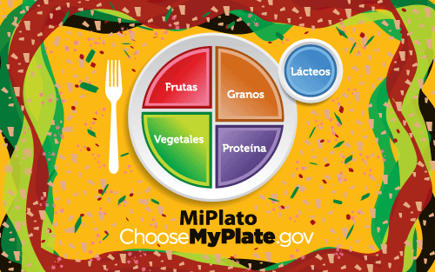
chooseMyPlate.gov

Slide 29
Acknowledgments
Lindsey Parsons, Co-Director
Real Food for Kids - Montgomery
Cheryl Issa, MS RD
Pediatrict Nutritionist, Walter Reed Med Cntr

Slide 30
Resources
www.ChooseMyPlate.gov
http://www.eatright.org/kids
www.realfoodforkidsmontgomery.org
http://www.cnpp.usda.gov/Publications/DietaryGuidelines/2010/PolicyDoc/PolicyDoc.pdf

Slide 31


Thank you. ? Questions ?

