Slide 1

School Food Forum: Creating a Vision of Fresh, Real Food in Montgomery County, MD
Nov. 2, 2013
Kathy Lawrence
Director of Strategic Development, School Food FOCUS

Slide 2
One in every three
American children
is overweight
or obese

Slide 3
If we don’t change what they eat, they’ll be the first generation of Americans to live shorter lives
than their parents.

Slide 4
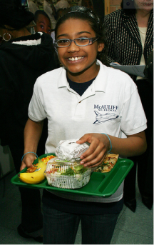
The Power of Procurement
32 million children eat school lunch
13 million eat breakfast
Nearly 20 million received lunch free or at reduced price
Over $14 billion per year spent
Huge potential to reduce health disparities and shift food systems

Slide 5
… is a national collaborative that leverages the knowledge and procurement power of large school districts to make school meals nationwide more healthful, regionally sourced, and sustainably produced.
Notes:
36 of the nation’s largest districts have signed the FOCUS stakeholder pledge, along with over 40 community partner organizations.

Slide 6
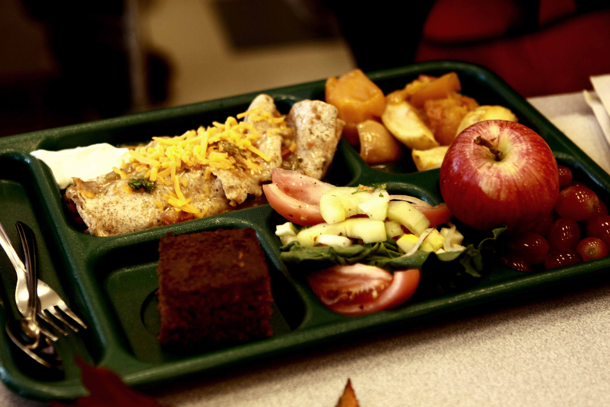
The Power of the Public Plate
Photo by Cynthia Torres

Slide 7
..to transform food systems make school meals to support students’ academic achievement and lifelong health, while directly benefiting farmers, workers throughout the food chain, regional economies, and the environment.

Slide 8
Urgency
+
Vision
+
Pragmatism
Notes:
URGENCY: kids need better food now. Schools are by no means the only source of food. But they are important, and in districts with high free & reduced eligibility rates (e.g. high poverty) school food provide 2/3 or more of student’s calories—it’s vital that they are healthful.
VISION: School food systems that support triple bottom line—economic, environmental and social justice
PRAGMATISM: Pursue significant, incremental changes while holding fast to—and continuing to articulate and work towards the long-term vision

Slide 9

Process Of Procurement Change
Supply Chain
Discovery
Peer
Learning
Policy
Procurement change

Slide 10

Saint Paul Learning Lab outcomes
More local produce in menus, in greater variety
Transition from 100% white to 53% whole grain buns
Locally sourced chicken cooked from scratch
Sugar reduction in flavored milk
Direct connections with growers/a more transparent supply chain
Notes:
@40,000 kids

Slide 11

Denver Learning Lab outcomes
Increase in local produce procurement
New relationships with local vendors
Denver-based cook-chill processor (chili, salsa, beans)
CO sustainably grown beef
Installation of salad bars district-wide
Staff training in scratch cooking
Purchasing of student-grown produce
Notes:
More than 70,000

Slide 12



Chicago Learning Lab outcomes
Fresh scratch-cooked chicken in 473 schools:
Direct from USDA Foods
From local growers who do not use antibiotics
Lower sugar, higher fiber breakfast cereals from an entrepreneurial supplier new to school food service.
Lower sodium processed cheese.
Notes:
Third largest district in the nation, more than 400,000

Slide 13
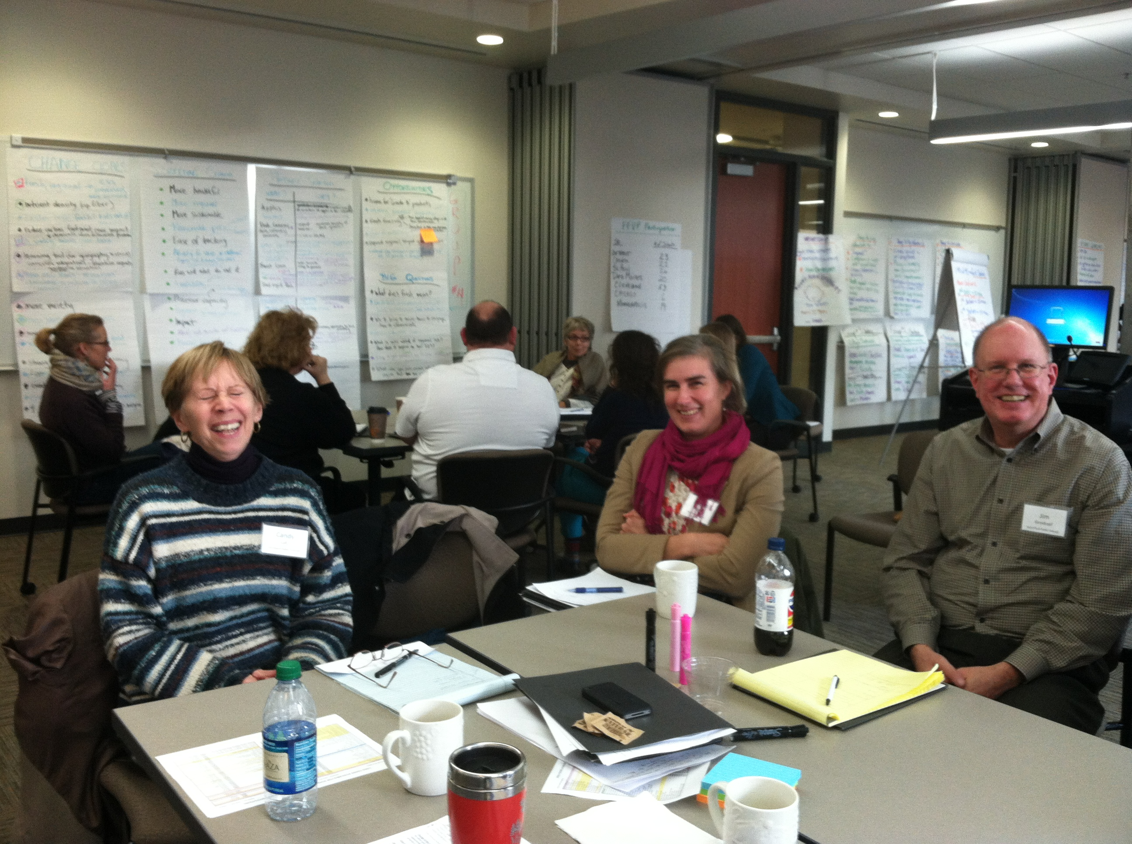
Multi-district procurement efforts
Regional Learning Lab
National Procurement Initiative

Slide 14
Regional Learning Lab (RLL)
Multi-district, Midwest region—consensus on HRS priority foods
7 school districts
Serving ~700,00 children
$407 million in purchasing power

Slide 15
Regional Learning Lab (RLL)
FUNDERS
W.K. Kellogg
Kresge
Surdna
Lowenstein
Robert Wood Johnson

Slide 16
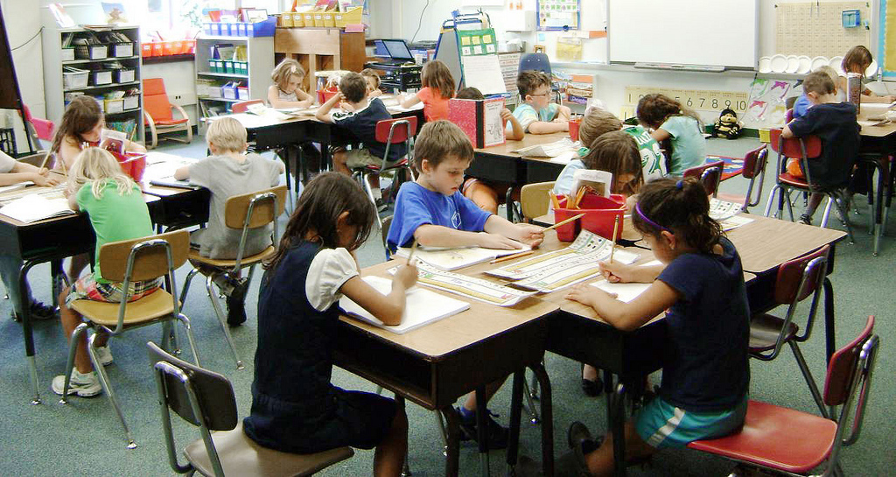
Regional Learning Lab
Student Enrollment for School Year 2012-2013
Photo Source: www.flickr.com/photos/usdagov/6241138870/
Total Enrollment: 690,533 Students

Slide 17

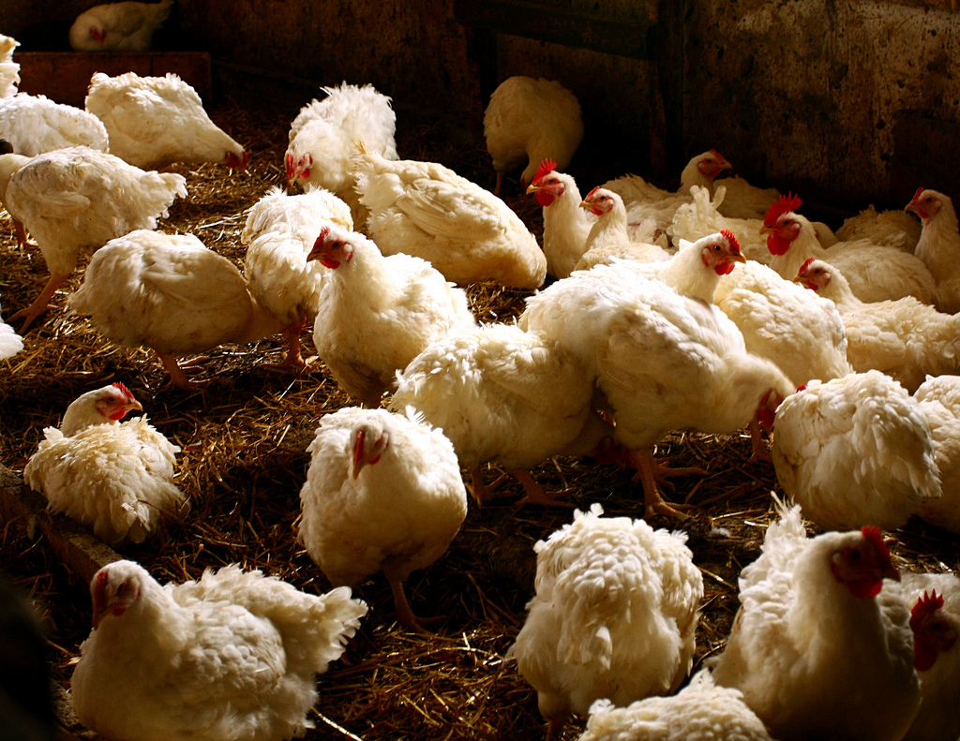
Supply
Chain
Discovery
Explore options within commercial market and USDA Foods.
Be creative: include growers, processors and products that do not currently serve the K-12 market.
Reach out to all processors large enough to serve one, some, or all districts, all along scale spectrum.
Investigate potential for local supply.
Identify gaps in infrastructure.

Slide 18
Combined Districts’ Food Priorities: After much deliberation, the work groups are…
Work Group | Food items to start working on
Turkey | Clean label turkey roast (whole or sliced): Smoked Roasted
Beans/Grains | Start with regionally grown and processed pinto beans in shelf stable, not canned packaging; move towards a more healthful burrito
Fruit and Vegetables | RFI/RFP template including Geographic Preference and cosmetically imperfect seconds for: Fresh produce Frozen produce
Chicken | RLL decisions about chicken made within the National Procurement Initiative RWA/MSS drumsticks RWA/MSS chicken strips (like fajita without seasoning)

Slide 19
School Food FOCUS National Procurement Initiative (NPI)
… to shift large-scale national supply chains, both commercial and through USDA Foods, toward more healthful, regional, and/or sustainable foods.

Slide 20
National Procurement Initiative (NPI)
15 school districts, spanning 5 USDA FNS regions
Serving 1.9 million school children
$28 million in annual chicken purchasing power
More healthful, regional and /or sustainable chicken

Slide 21
National Procurement Initiative (NPI)
FUNDERS
Pew Charitable Trusts
The California Endowment

Slide 22
NPI School Districts
San Diego
Riverside
Oakland
Portland
Chicago
6. Cleveland
7. Des Moines
8. Detroit
9. Minneapolis
10. Omaha
11. Saint Paul
12. New York City
Houston
Nashville
Louisville

Slide 23

Wanted: Healthier chicken—
on the plate AND in the environment.

Slide 24
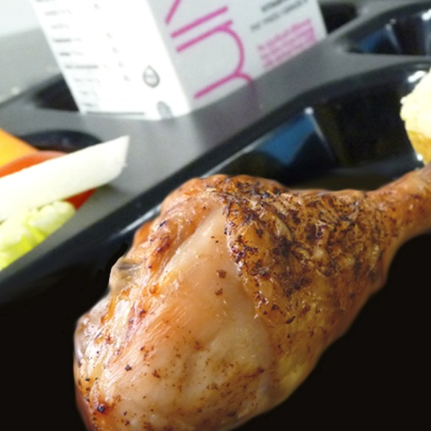
NPI
Change
Goals
“Chopped & formed” → minimally processed whole muscle chicken
Increase fresh & fresh-frozen chicken
Address antibiotics
Spur regional supply

Slide 25

The power of love – a call to action!

Slide 26
Thank you!
Kathy Lawrence
klawrence@schoolfoodfocus.org

Slide 27
www.schoolfoodfocus.org
Find us online:

