Slide 1
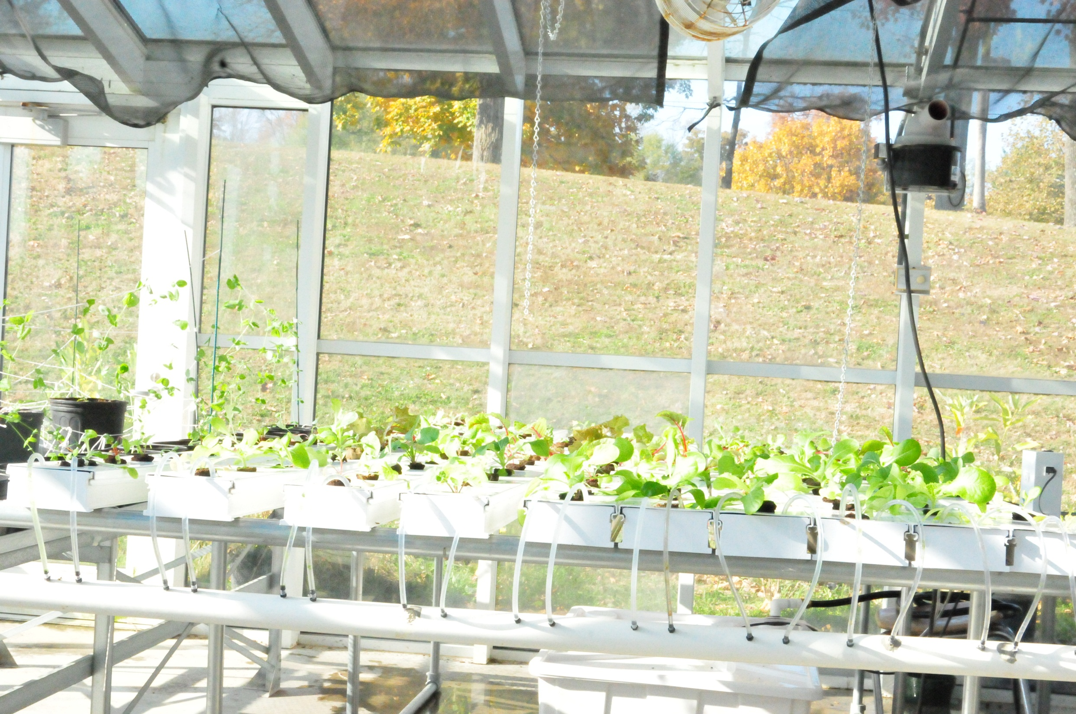
Growing Edible Plants at Sherwood High School
Growing Edible Plants at Sherwood High School
Jill Coutts
Horticulture Teacher
Jill Coutts
Horticulture Teacher

Slide 2
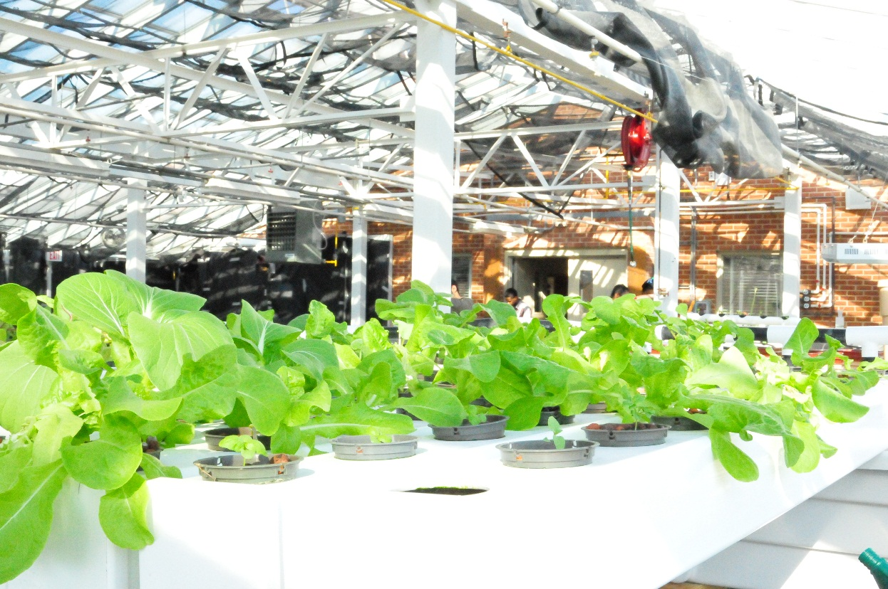
The Greenhouse at Sherwood High School
Greenhouse complex includes approximately 3,000 sqft of growing space complete with commercial benches, heating and cooling system, and water access.
Head house for potting and labs
Classroom space

Slide 3
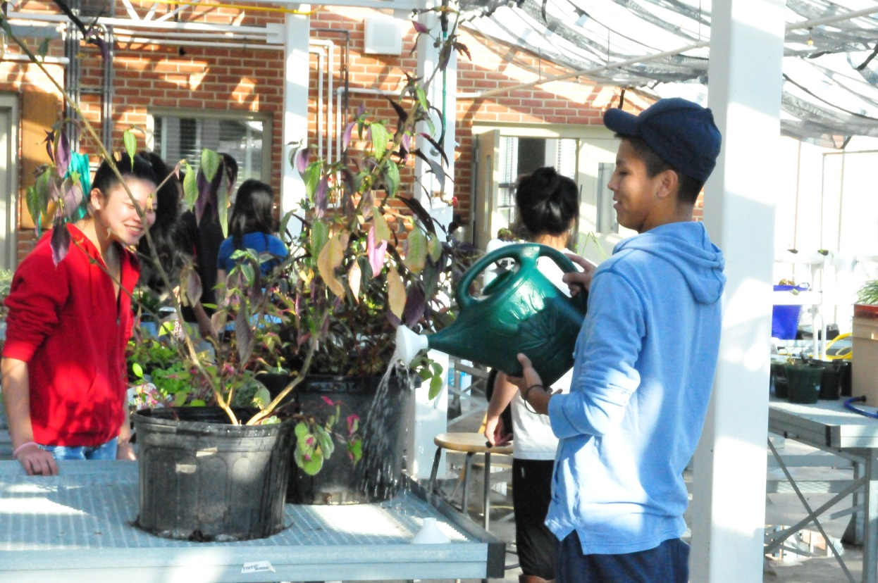
Greenhouse as Classroom
Students use the greenhouse from August through June
This includes afterschool use
Growing of plants includes ornamentals, native perennials, and edible plants
Students are active participants in their community as they grow plants for gardens, restoration projects and beautification.

Slide 4
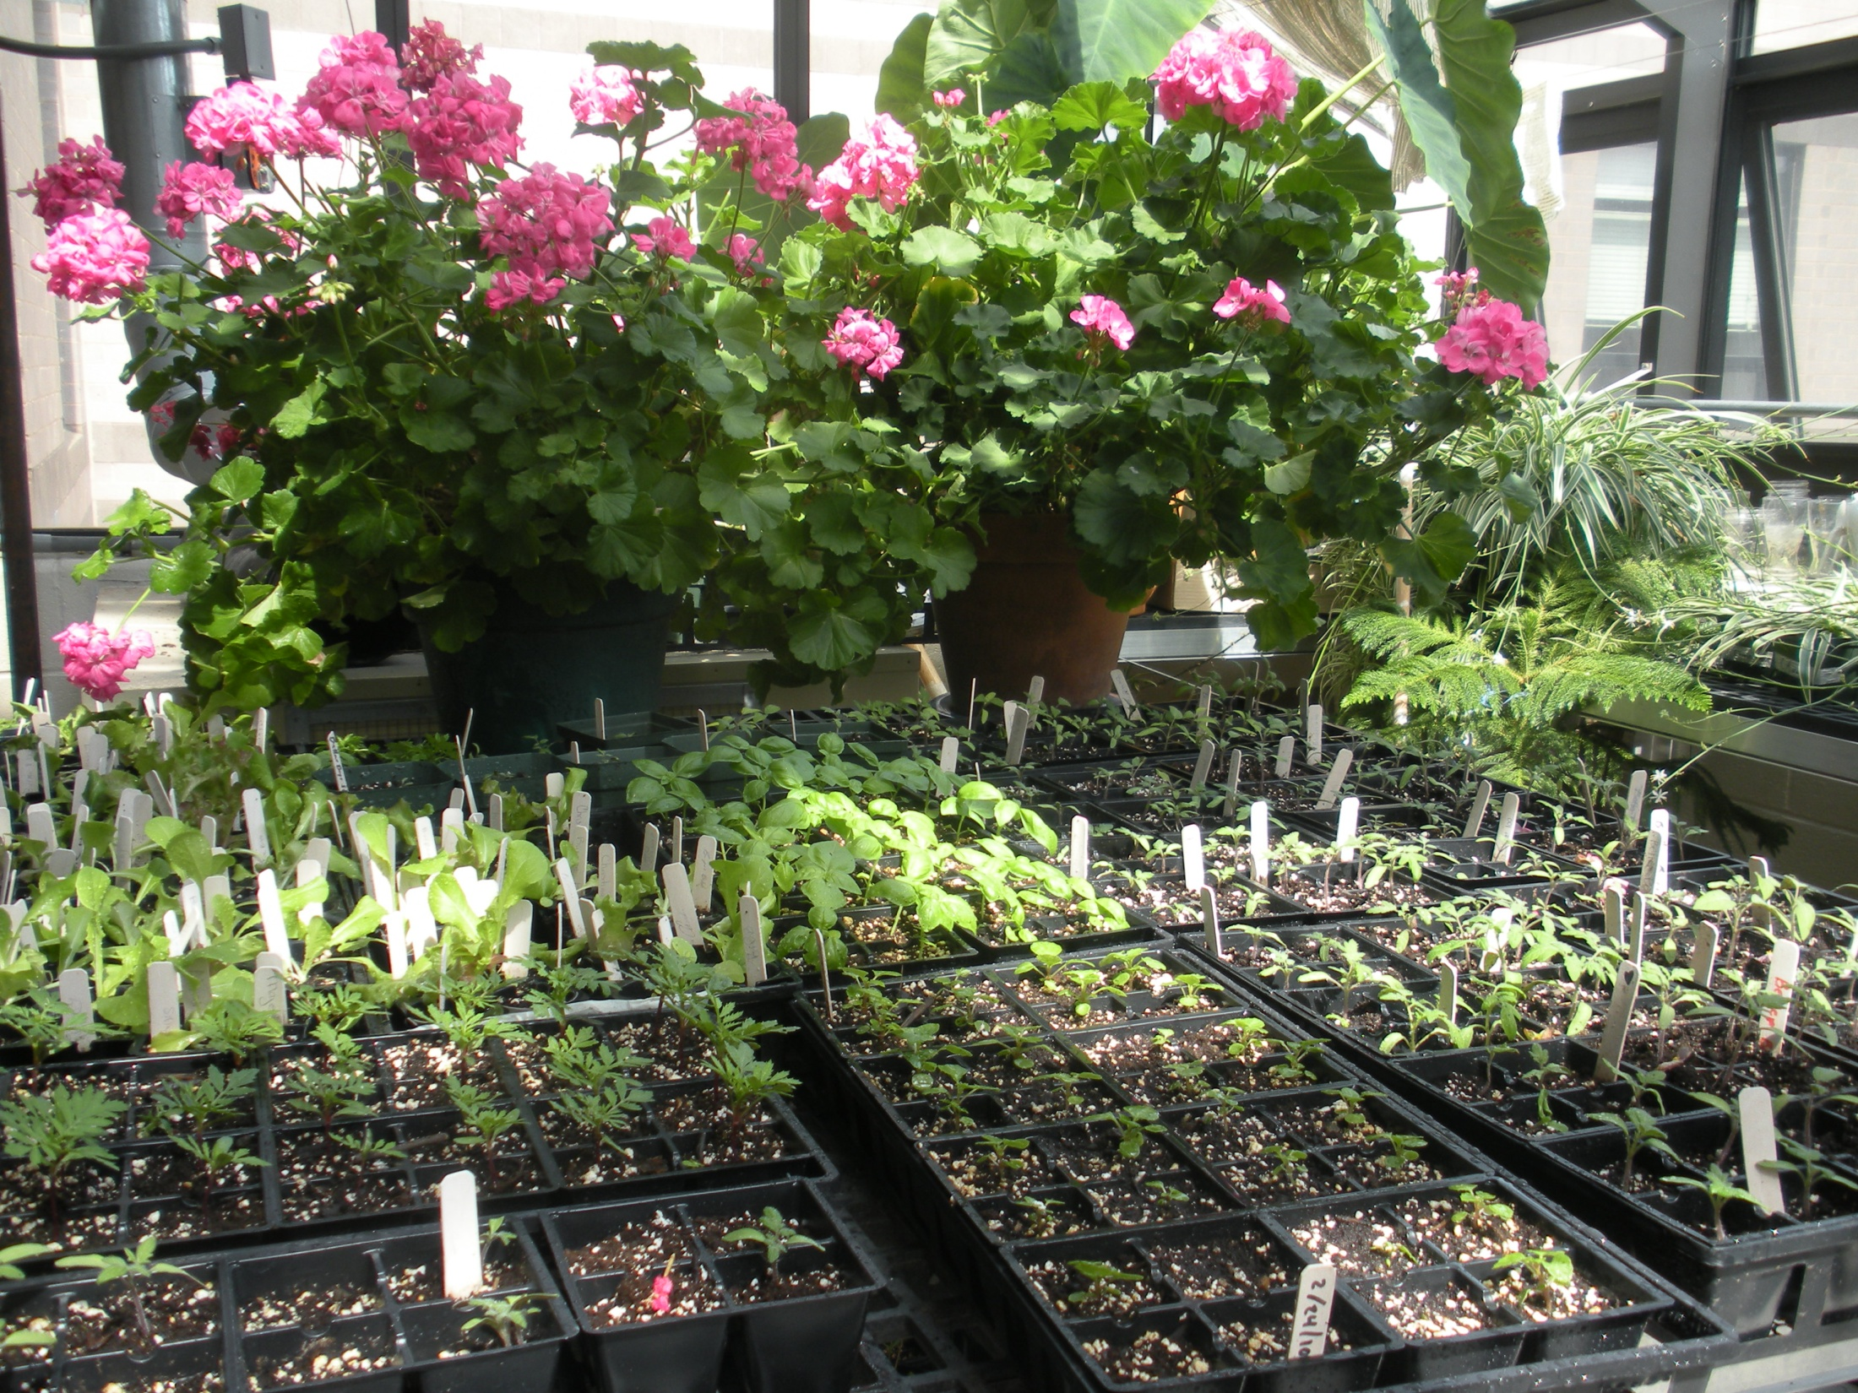
Learning Plant production right at school

Slide 5
New Environmental Horticulture Pathway in Montgomery County Public Schools
Curriculum development over 10 years.
Rigorous, Problem-Based Learning
A four year program that culminates with an internship:
  Foundations of Horticulture
  Plant Production
  Landscape Design

Slide 6
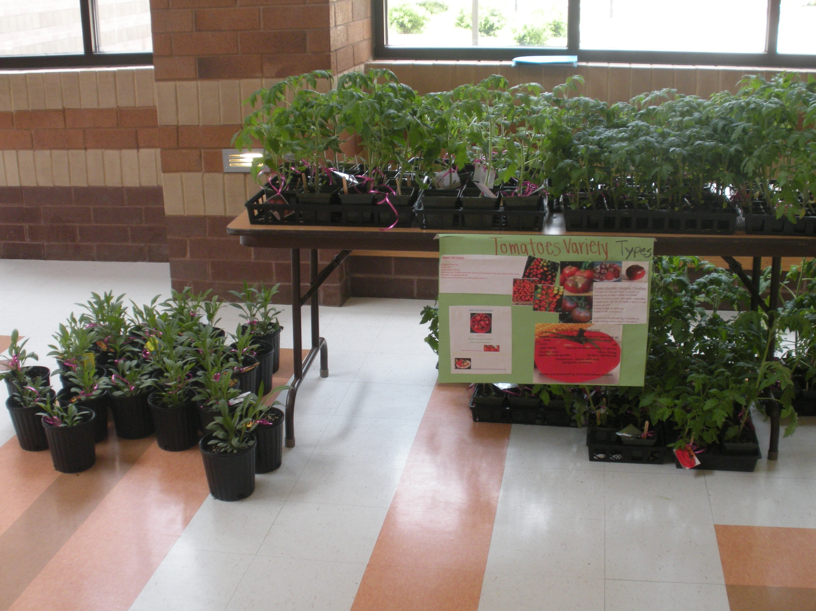
Sample Schedule
Grade 10 | Grade 11 | Grade 12
On-level or Honors English | On-level, Honors or AP English | On-level, Honors or AP English
On-level or Honors Algebra II | On-level or Honors Pre-calculus | On-level or AP Calculus
On-level, Honors or AP NSL | On-level, Honors, or AP World History | Elective
On-level or Honors Biology | On-level or Honors Chemistry | Advanced Placement Environmental Science
Fine Arts
 | Plant Production
Foundations of Horticulture | Landscape Design | Capstone Experience
Notes:
Students that participate in this pathway will be encouraged to take rigorous coursework. All interested students contact me for more information.

Slide 7
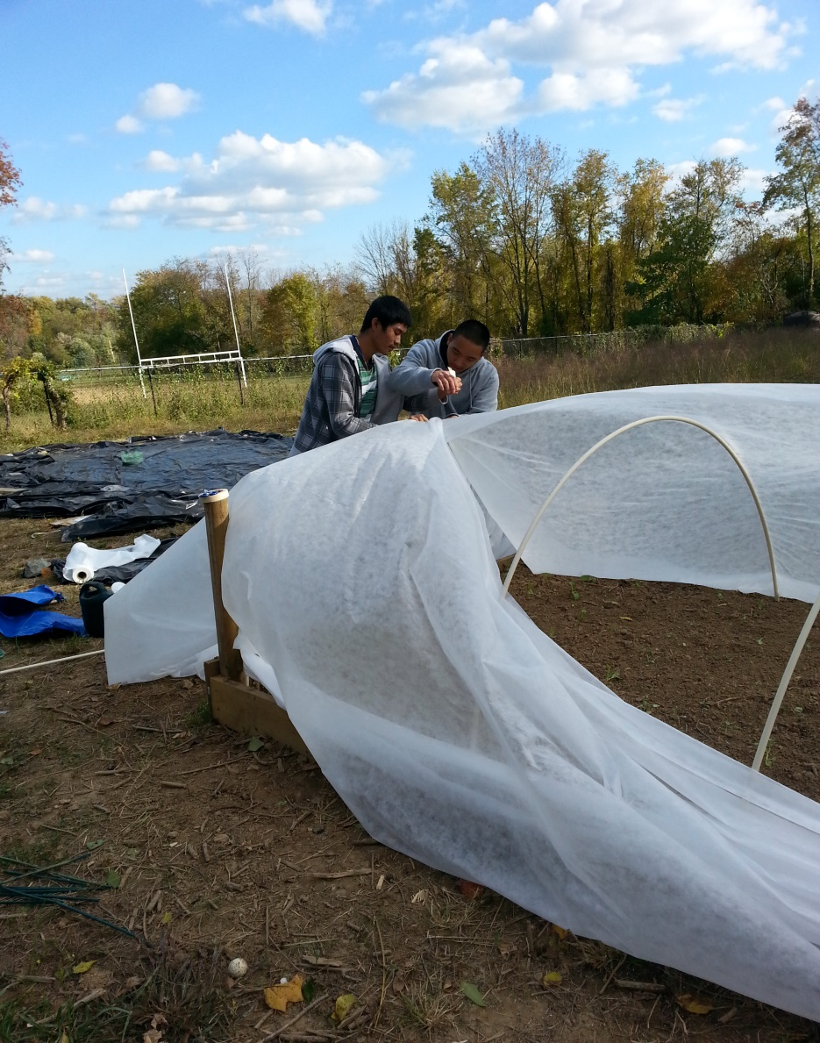
Problem Based Learning – Student focused, directed, and based on the Engineering Model
Students learn about plant anatomy and physiology and growth needs through their research.
Students design and build model prototypes to grow plants, whether hydroponically or in soil.

Slide 8
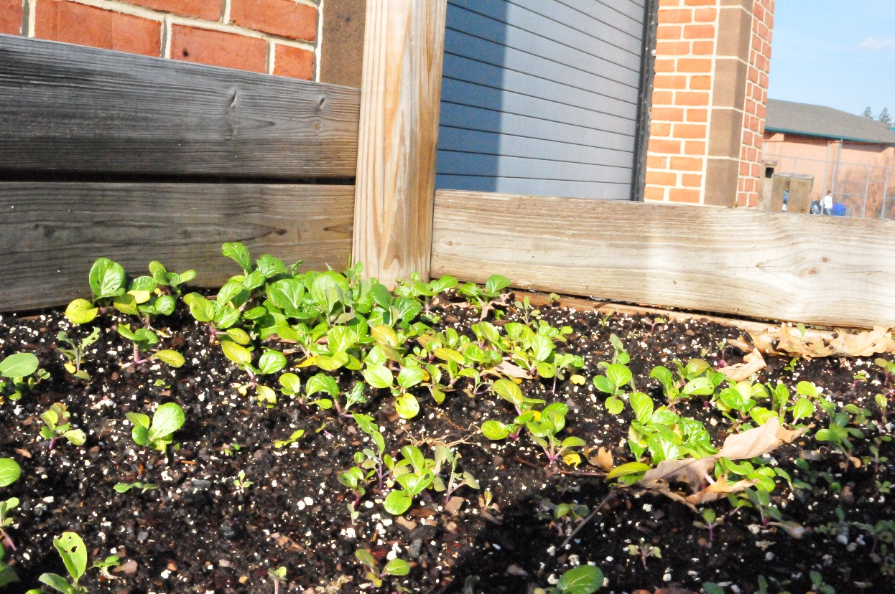
Raised Beds
Raised beds are located at the south facing side of the greenhouse brick wall.
The raised beds were built as an Eagle Scout project. Awesome!
The location is perfect – south facing and brick allow plants to be grown almost year-round

Slide 9
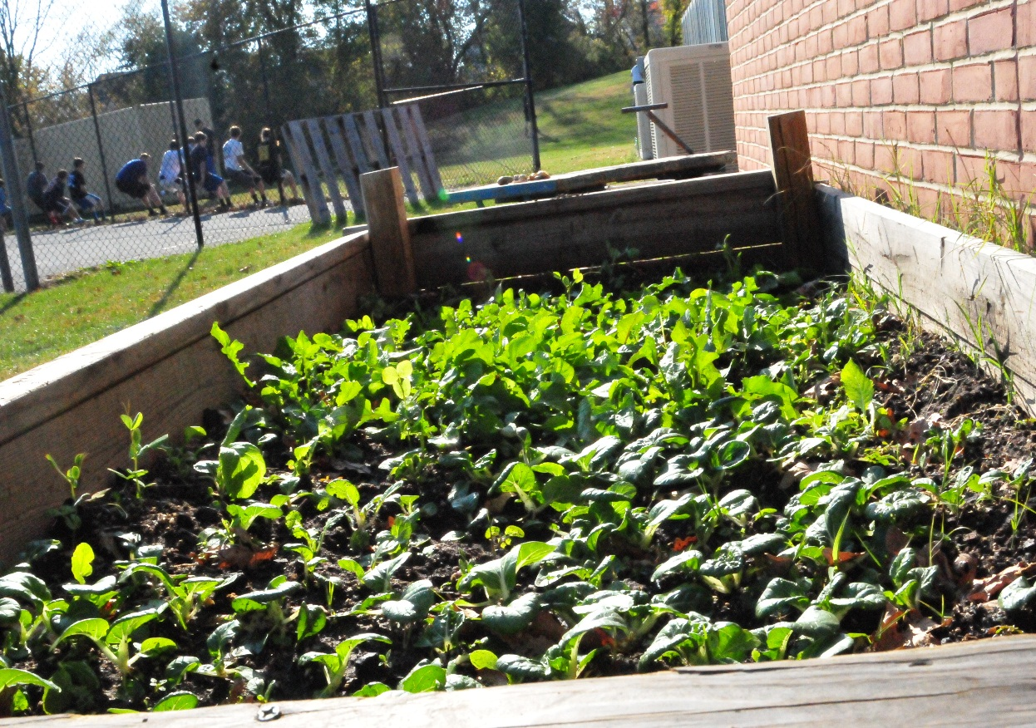
Built with student needs in mind
One bed is hip height to allow wheelchair access
Can be converted to cold frame for use in winter with cover or plastic
Seating is around the bed for ease of weeding, planting, and harvesting

Slide 10
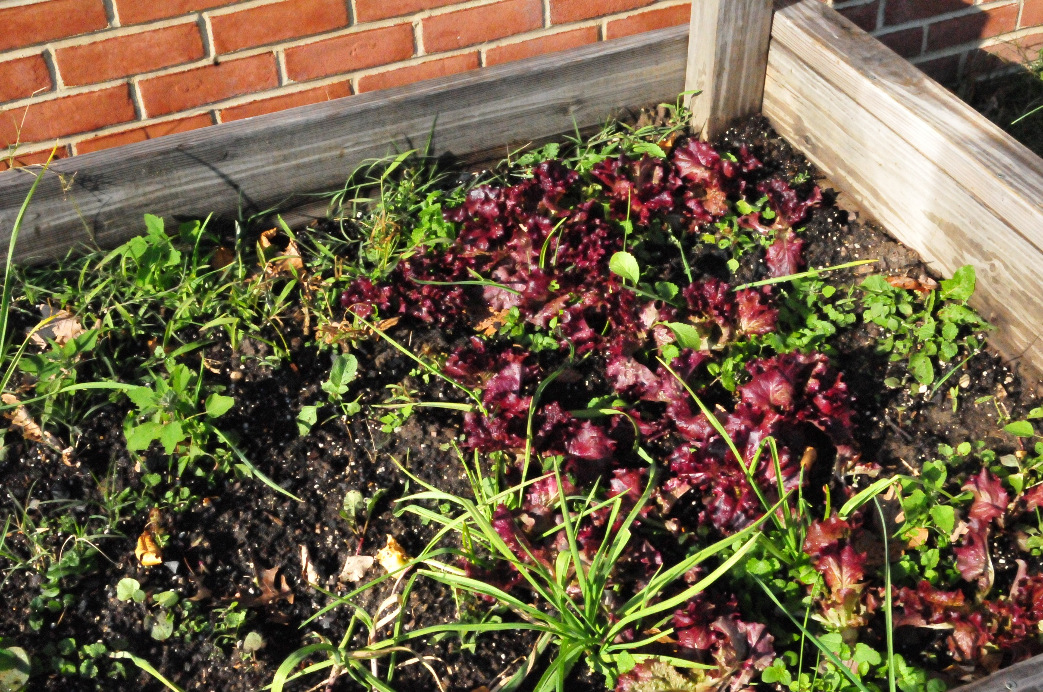

Slide 11
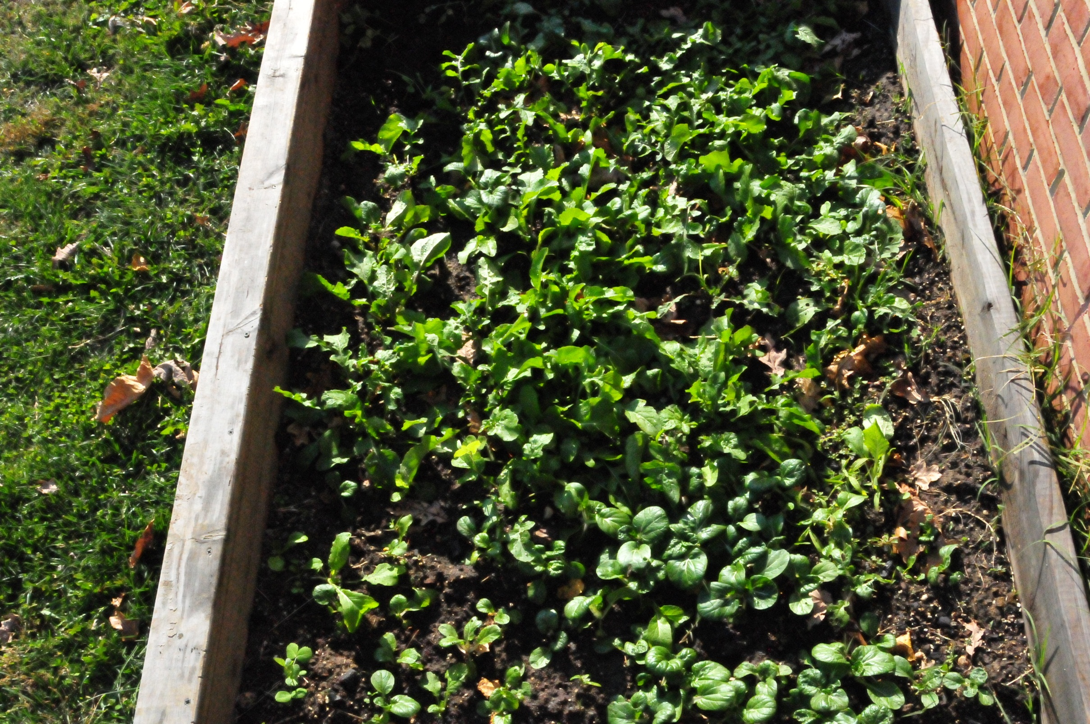

Slide 12


Slide 13
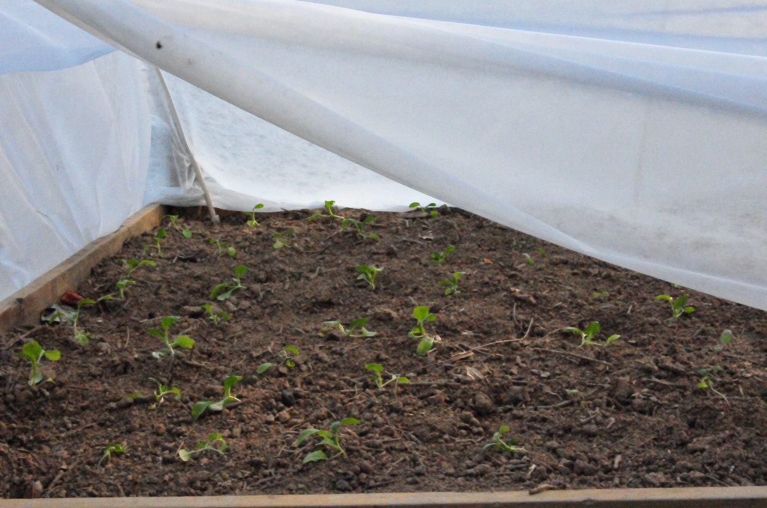
Urban Farm – part of the new Plant Production unit of study
Students have about an eighth of an acre to farm
They are in the process of building raised beds to grow vegetable crops and cut flowers to sell at local farmer’s market
Environmental Horticulture pathway students will be able to use the area for internships.

Slide 14
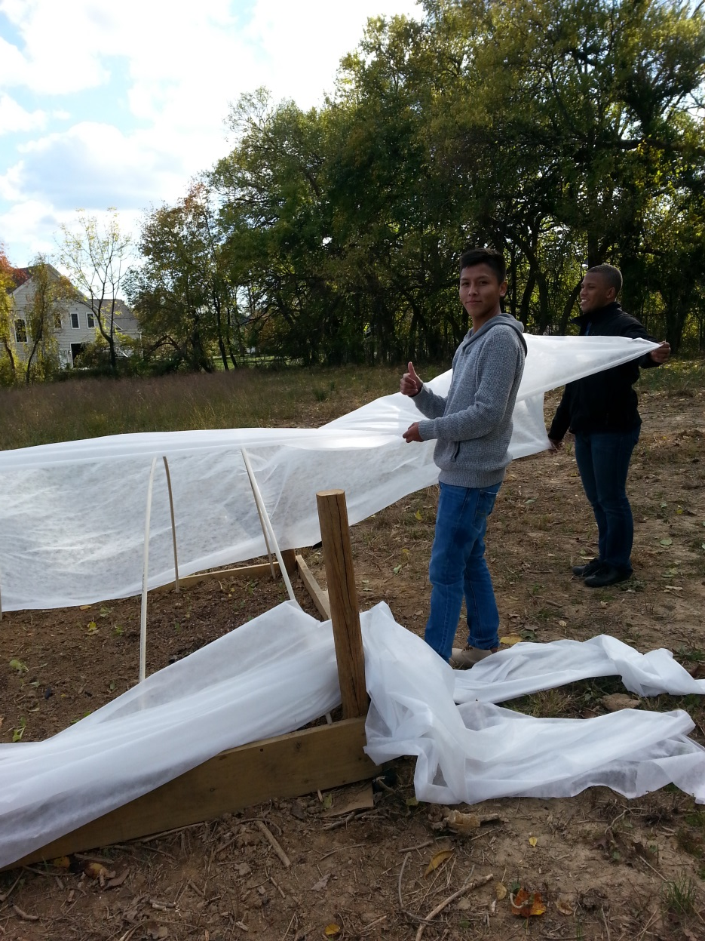
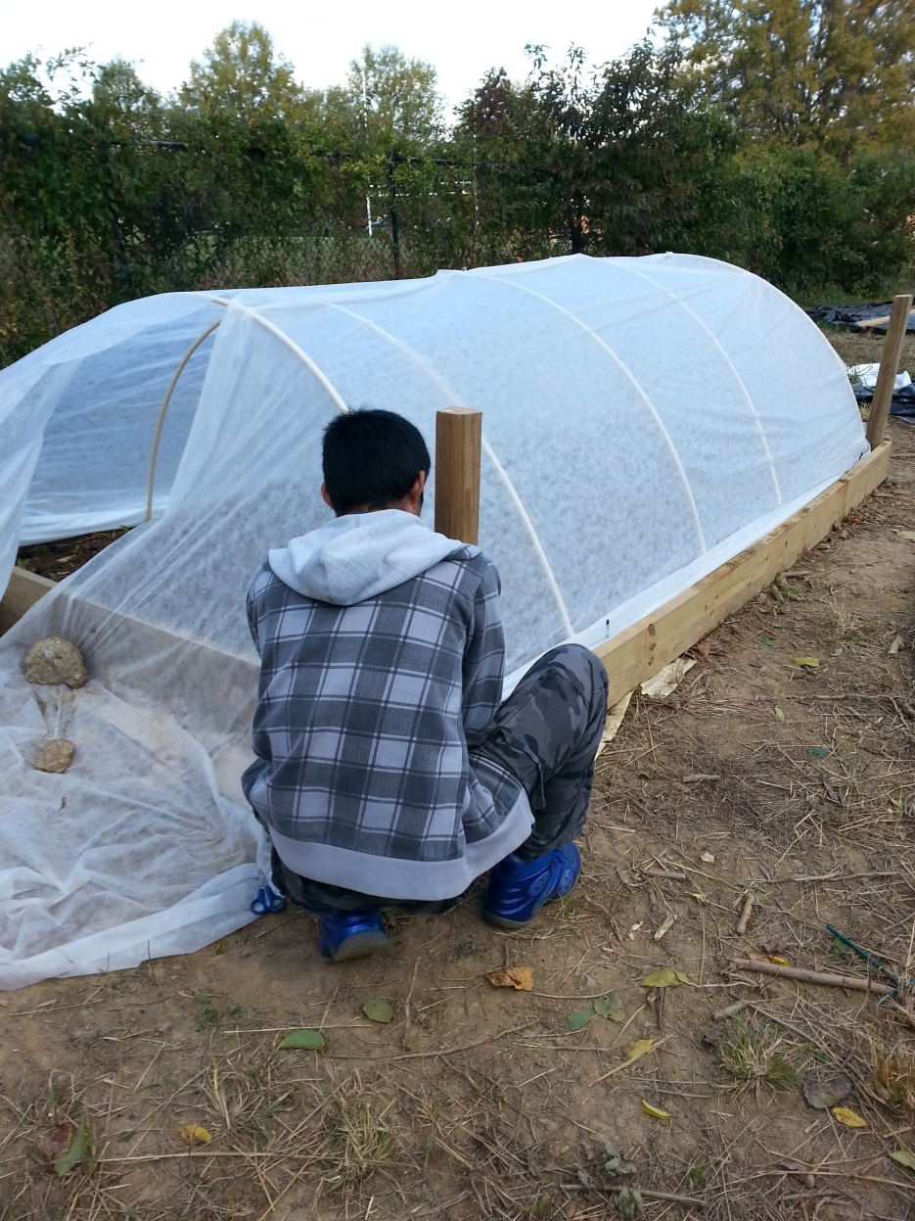
Raised beds with “hoop house” feature

Slide 15
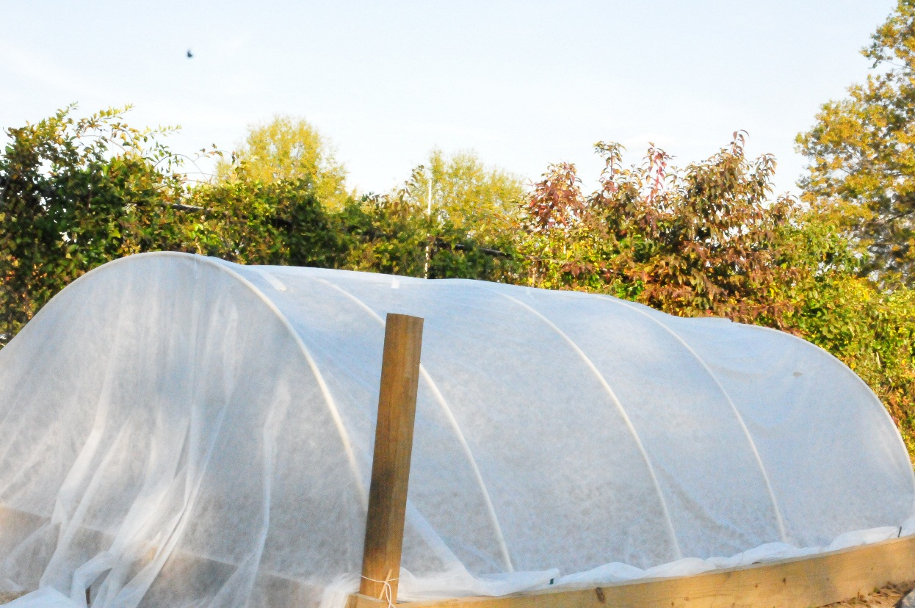
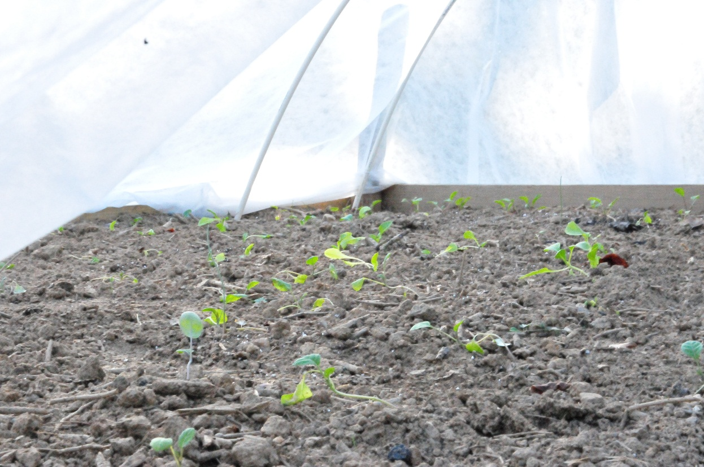
12X 6 foot raised bed was built entirely by students. They added the hoop-house feature to grow throughout the winter.

Slide 16
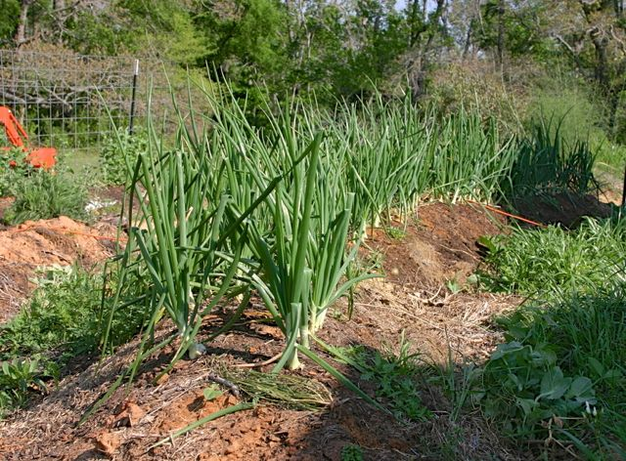
Next project: Hugelkultur Raised Beds

Slide 17
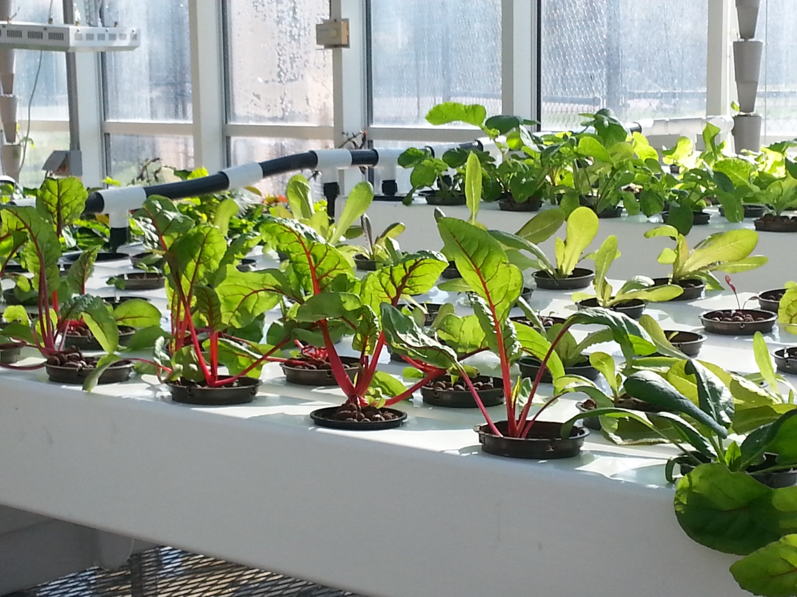

Aeroponics systems to grow edibles!

Slide 18

All systems are planted and maintained by students. Nutrient Film system for growing lettuce.

Slide 19
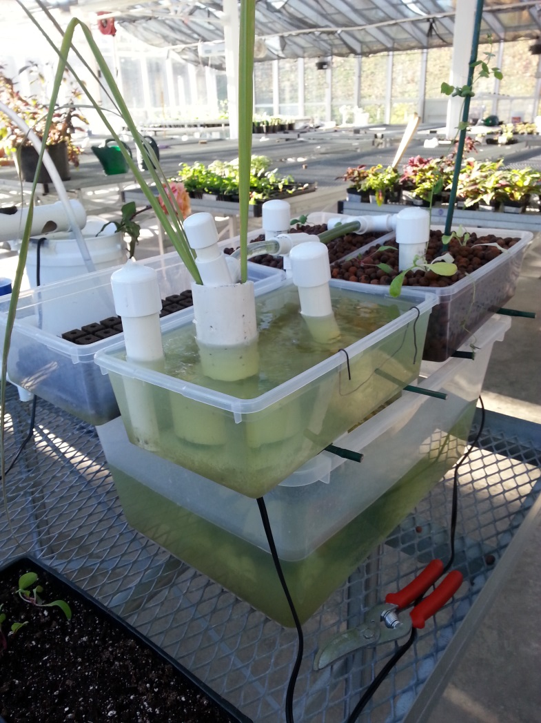
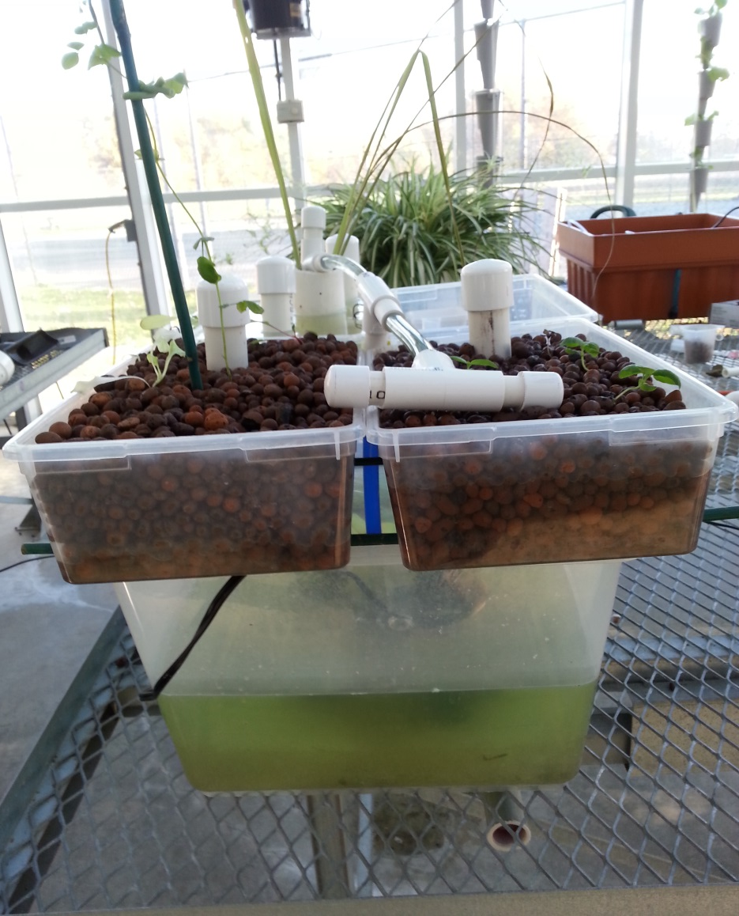
Student Designed Prototype for Aquaponics System

Slide 20
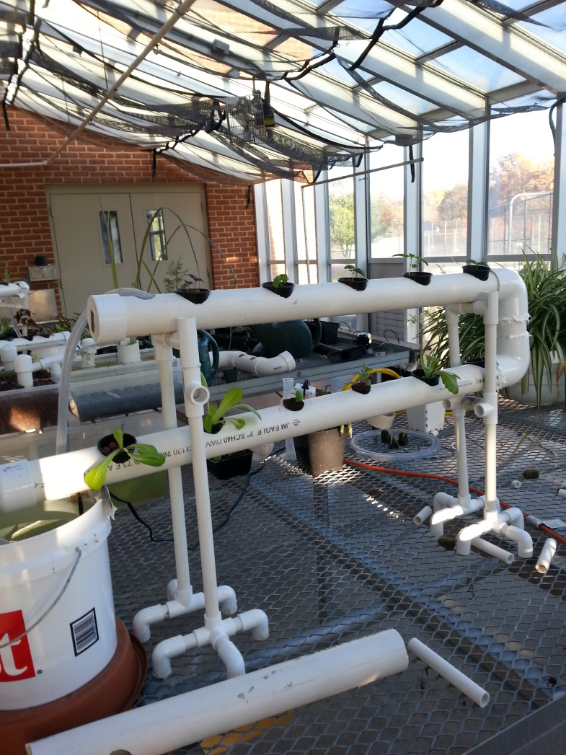
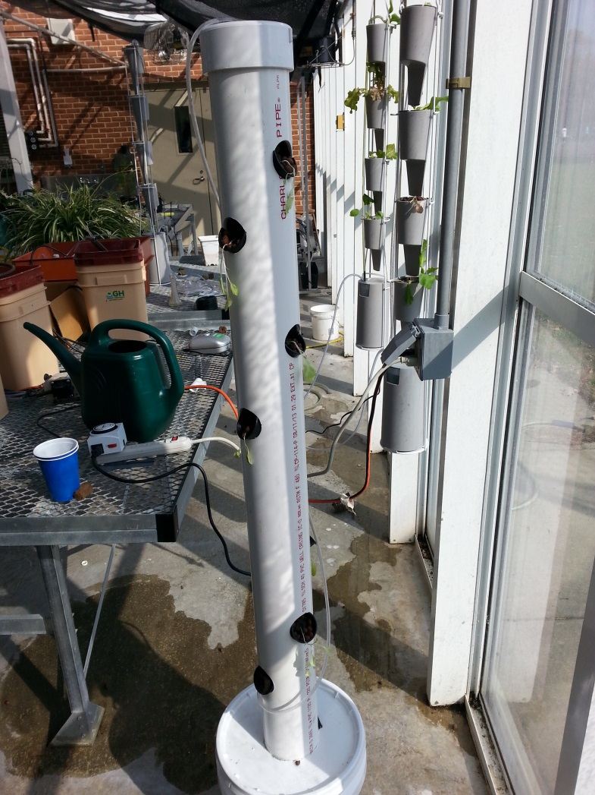
Another Example of Student Designed Hydroponic Systems

Slide 21
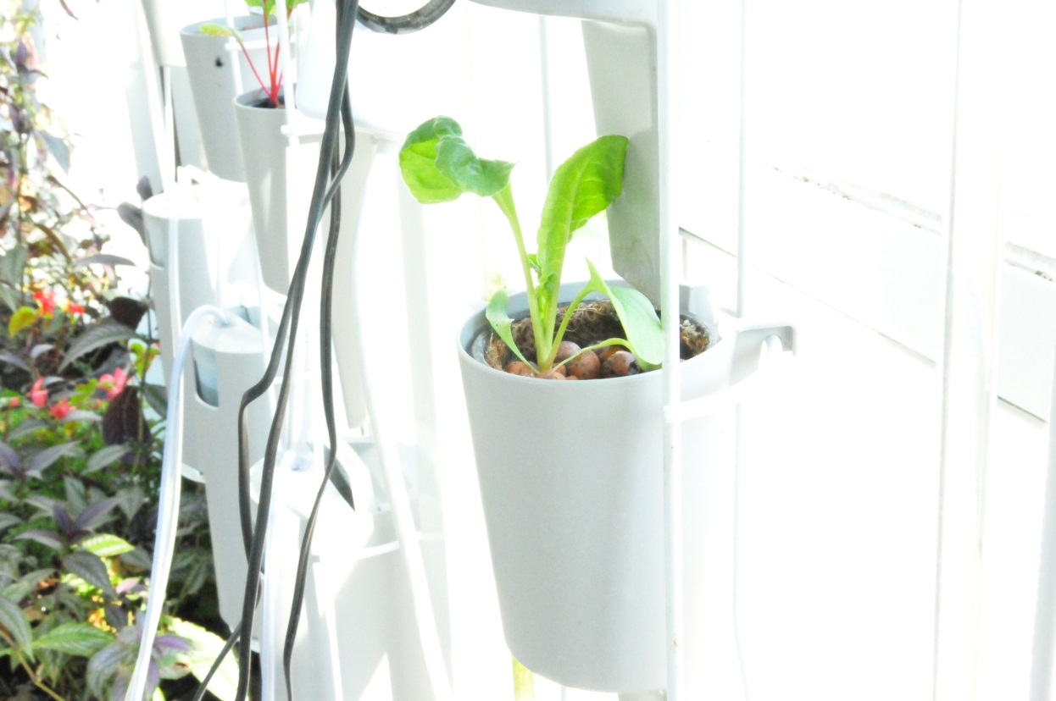
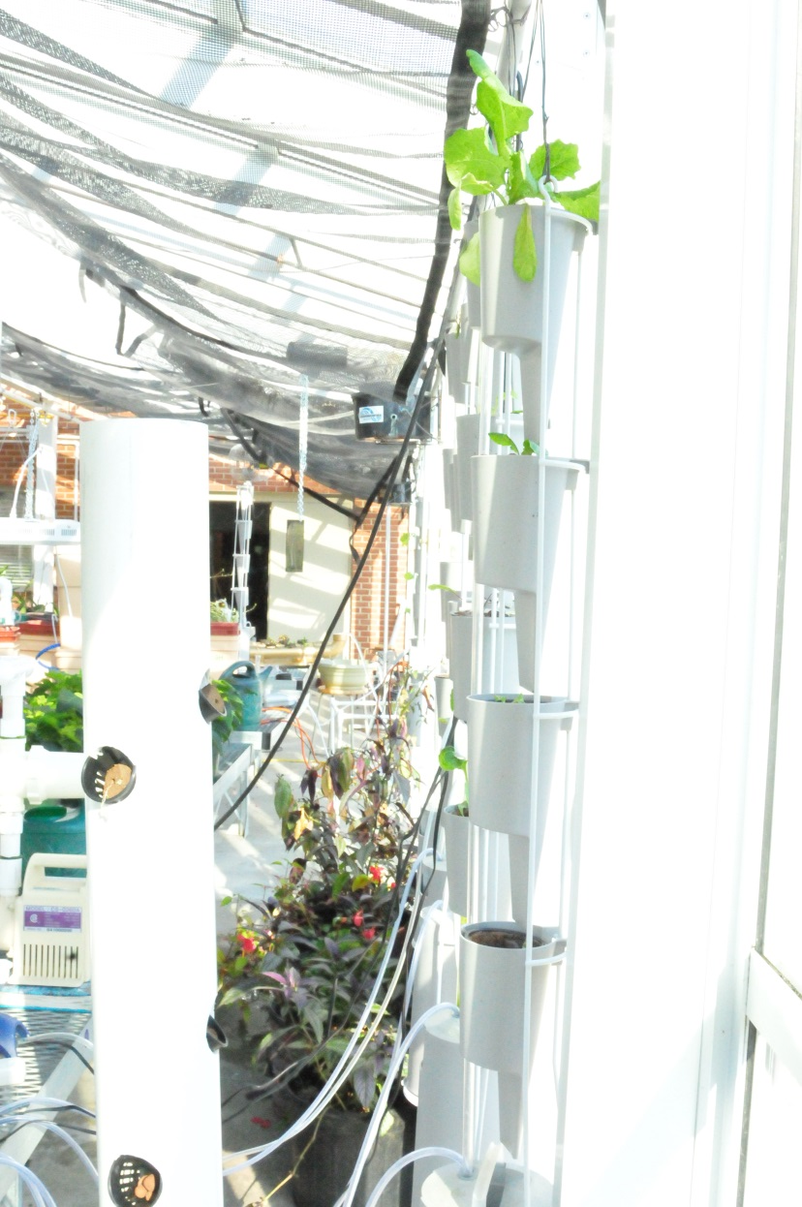
Window Farms to Garden At Home

Slide 22
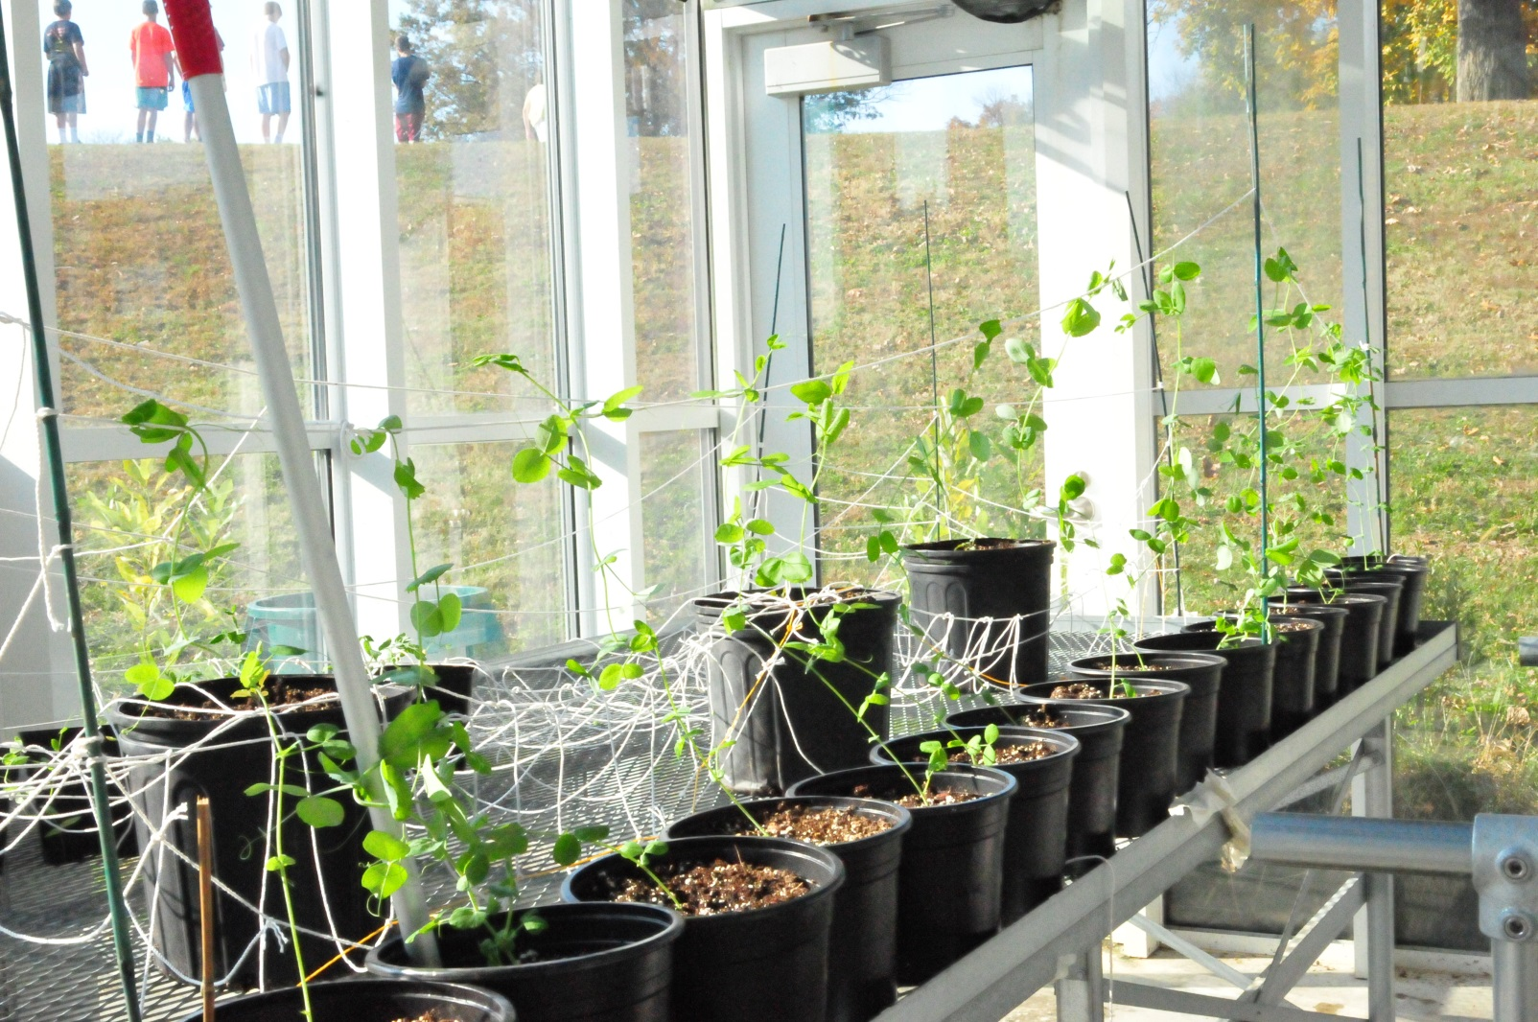
Students are Creative and Innovative!

Slide 23
The “So What?” What Are The Benefits to Students?
Growing plants is transforming!
Higher order thinking
Builds creativity and ingenuity
Character Building!
Stress reducing
Answers the question: Where does food come from?
Kids really love to grow plants!

